Slide 1
Social Security – Our Earned Benefits
Alliance for Retired Americans
2023

Slide 2
Video

Slide 3
Social Security 101

Slide 4
65.2 Million Beneficiaries
50.2 million receive retiree benefits 5.9 million receive survivors’ benefits including more than 4 million children 8.9 million receive disability benefits
Social Security Administration, 2023

Slide 5
Primary Income Source for Most Older Americans
For 1/3 of current beneficiaries – 90% of income is from Social Security
For 2/3 of current beneficiaries – 50% of income is from Social Security
Average Monthly Benefits are Modest
Retired worker $1,677 Retired couple $2,753 Disabled Worker $1,364
Department of Labor, 2022

Slide 6
Younger Workers and Social Security
9% of millennials have received Social Security because their working parent died, became disabled, or retired
A young person starting a career today has a 30% chance of being disabled before 67
Social Security likely to provide most younger Americans’ income in old age
Lack of traditional pensions; only 1/3 have a retirement savings plan at work
65% of people 18-29 want NO reduction in Social Security, but only 15% believe Social Security will have enough money to provide benefits at current levels
Pew Research Center (2020) and Center for
Budget and Policy Priorities (2021)

Slide 7
How is Social Security Funded
Worker + Employer each contribute 6.2% of every paycheck
2023 Contributions are capped at $160,200 per year, per employee
Bond interest and tax revenue on high-earner beneficiaries

Slide 8
Benefits Are Guaranteed
Benefits are calculated on a person’s lifetime earnings, and are guaranteed no matter how long they live

Slide 9
Does Not Add to National Debt
Social Security cannot spend more than is in its Trust Funds or borrow money
Should funds become depleted in the future, benefits would be reduced

Slide 10
Social Security is Solvent
Can pay full benefits for the next decade
If nothing changes, Social Security can pay 77% of scheduled benefits after 2033

Slide 11
Social Security Has Broad Public Support
78% of ALL Citizens Say Social Security Should Receive the Same or MORE Funding
Notes:
This is especially true among people over the age of 45.

Slide 12
Lift Or Eliminate Cap on Contributions
Strengthen the Trust Fund Provide Revenue to Increase Benefits
Ensure Social Security is There for Current and Future Beneficiaries
Restores Fairness

Slide 13
Other Changes Needed to Improve Social Security
Repeal WEP-GPO Provisions so public sector retirees receive all earned Social Security Benefits
Change the Cost-of-Living Adjustment formula to Better Reflect What Seniors Spend Money On (CPI-E)
Provide Social Security Work Credits for Caregivers

Slide 14
Political Threats Are Real

Slide 15
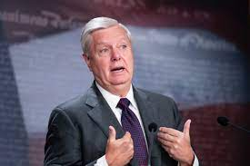
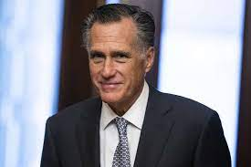
Raising the Retirement Age
Sen. Lindsey Graham: “…To get out of this mess, people like me are going to have to take a little less and pay a little more in. We’re going to have to adjust the age one more time like Ronald Reagan and Tip — Tip O’Neil did. …”
Sen. Mitt Romney: “…you have to recognize that life expectancy is a lot more today...”
Yahoo News, June 2022; NBC.com March 2023

Slide 16
Are Americans Living Longer?
Average American’s Life Expectancy is 76 years
BUT Americans with lower-incomes do not live as long as those with high incomes Men in the top 10% in household income could expect to live to 88, while those in the bottom 10% could expect to live to just 76
Life Expectancy Varies Significantly by Race White Americans – 76.4 years
Black Americans – 70.8 years

Slide 17
Raising the Retirement Age is a CUT
Example – Single Retired Worker Receiving the Average Yearly Benefit Amount Who Lives to Age 76
Age of Retirement | Yearly benefits | Lifetime benefits received until death at age 76 | Reduction
67 | $20,124 | $181,116 | –
68 | $20,124 | $160,992 | -$20,124
69 | $20,124 | $140,868 | -$40,248
70 | $20,124 | $120,744 | -$60,372

Slide 18
Privatization Schemes
Give All or Part of Trust Fund to Wall Street
NO Guarantee of Better Returns; Risk of Losses
Investment companies Would Make Billions in Commissions and Fees
Allow or Require Individuals to Create Private Accounts in Lieu of Guaranteed Benefits
Drains Money From the Trust Fund for Current Beneficiaries
Ends Guaranteed Earned Benefits
Private Investment Companies Profit from Commissions and Fees

Slide 19
“TRUST Act” / Special Commissions
“Expert Commissions” start from the idea that Social Security Must be Changed
Drastically Limit the Public’s Input
Provide Political “Cover” to Politicians
The “TRUST Act” even establishes “rescue committees” to meet behind closed doors and develop recommendations to improve solvency

Slide 20
House Members Proposed Changes in 2022
House Republican Study Committee
“Blueprint to Save America”
Raise the retirement age
Withhold payments to early retirees and/or higher earners
Allow private accounts
Endorsed by 157 House members in 2022

Slide 21
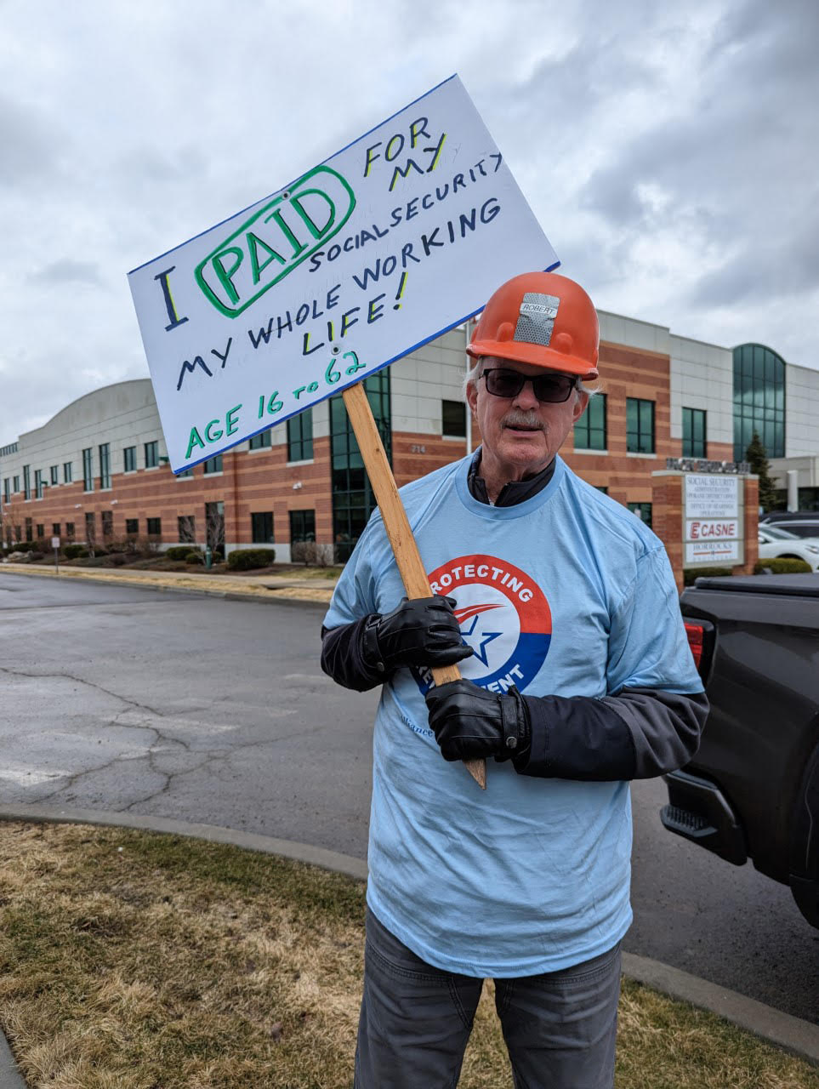
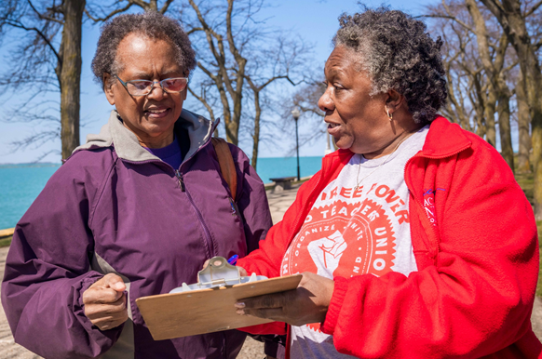
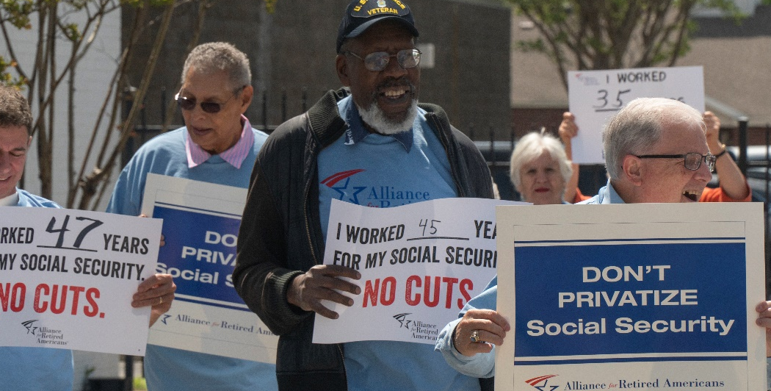
Fight Back
Step 1: Sign Our Petition Demanding NO CUTS to Social Security
Step 2: Get Involved with YOUR Alliance retiredamericans.org/join

Slide 22
Questions?
Comments?
www.retiredamericans.org

